Slide 1
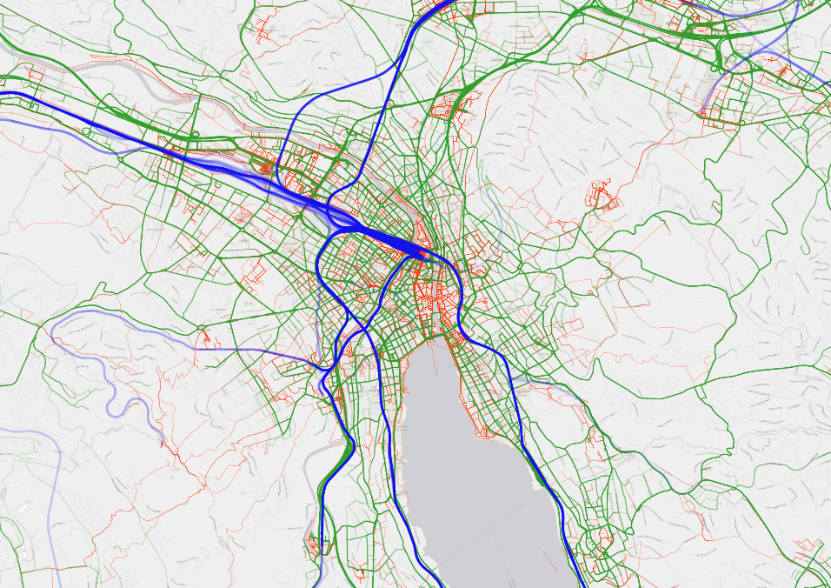
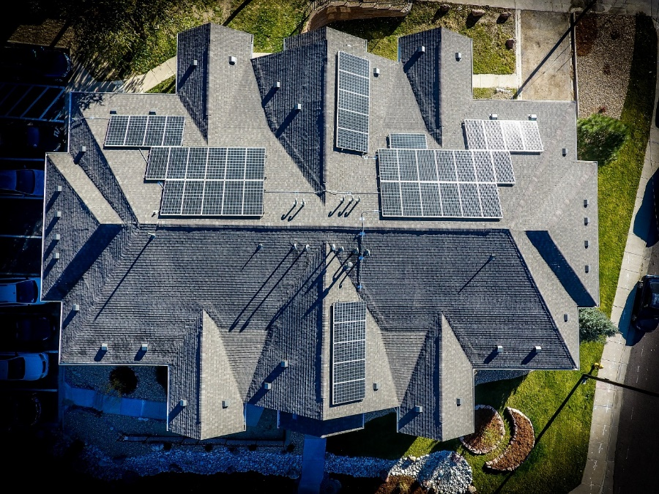
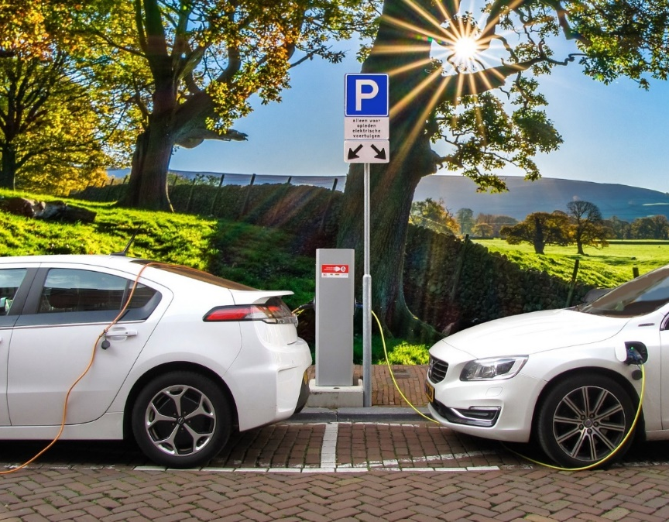

The Potential of Residential Rooftop Photovoltaic Energy to Charge Electric Cars for Daily Use
Henry Martin, René Buffat, Dominik Bucher, Martin Raubal
Chair of Geoinformation Engineering
Institute for Cartography and Geoinformation
ETH Zürich
Notes:
Hello everybody, my name is Henry Martin and I am presenting the work of my collegues and me from the char of Geoinformation Engineering from ETH Zurich.
We wanted to find out, How much can you charge your electric vehicle using only solar power generated on the roof of your own house.

Slide 2


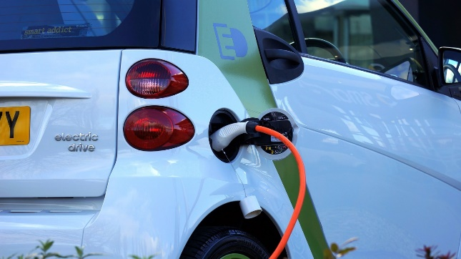
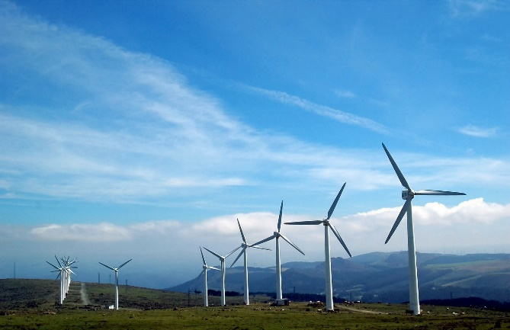

Localized consumption can help to mitigate expected stress on the distribution grid
Growing distributed power generation
Growing distributed power demand
(Power to X)
Stress for distribution grid
Notes:
Distributed energy generation, especially from solar, is growing rapidly. At the same time, electricity is planned to be used for decarbonization across all energy sectors (Power to heat via heatpumps, electric vehicles, power to gas).
The distributed generation in combination with the growing electricity demand is a challenge for the stability of the distribution grid.
A way to mitigate the stress on distribution grid is to localize the consumption. This means, to consume the power, directly where it is produced.
→ In our work, we investiage to what extent residential roof-top solar generation can be used to cover the electricity required for the personal mobility of electric vehicle users.

Slide 3
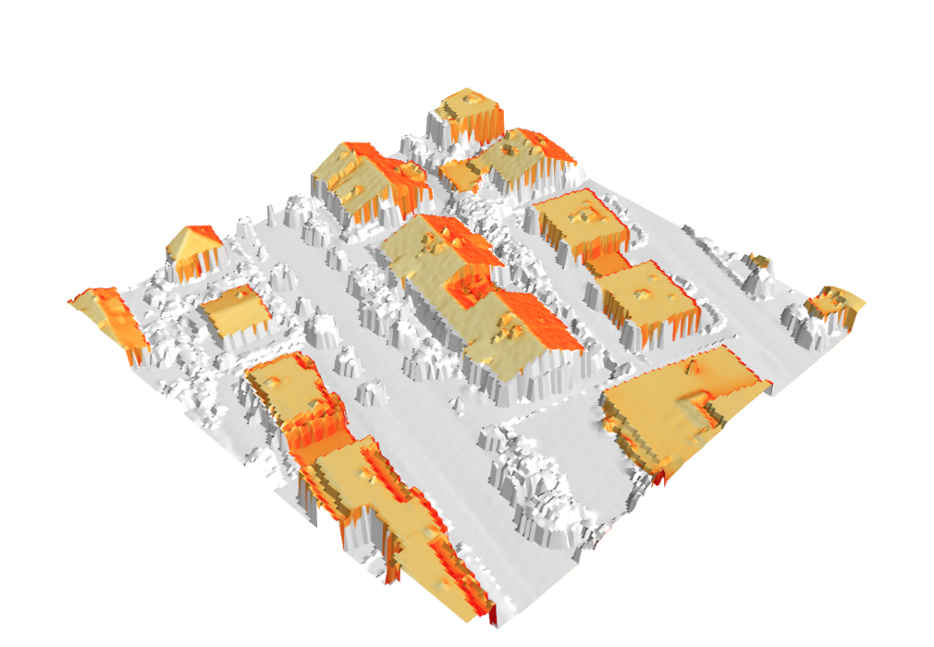
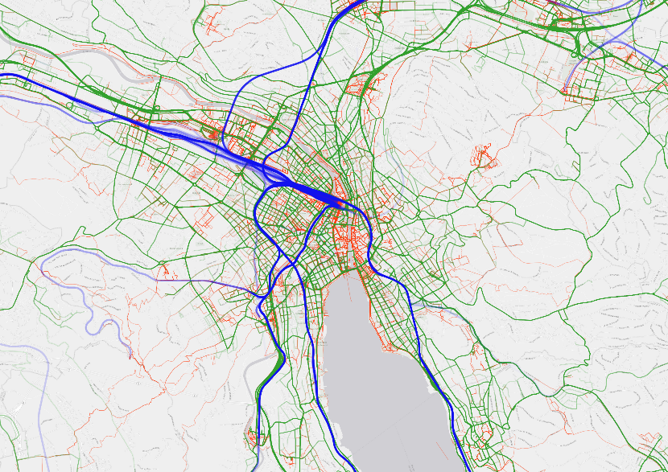
Combination of mobility data and solar irradiation potential to calculate the potential for local power consumption
Tracking data and mobility profiles of 90 EV owners, including SoC information
Personal solar generation potential for the home of each EV owner
Notes:
For this analysis we fuse data from the mobility domain together with data from the energy domain.
We use GPS tracking data and technical data recorded by the cars of 90 electric vehicle owners. This data allows us to know when the electric car is at home and how much energy is required to recharge it.
At the same time, we know the home addresses of the study participants and calculate their personal solar generation potential. This calculation is based on a high-resolution digital elevation model and includes the roof area, roof angle, potential shadowing effects and local weather conditions.

Slide 4
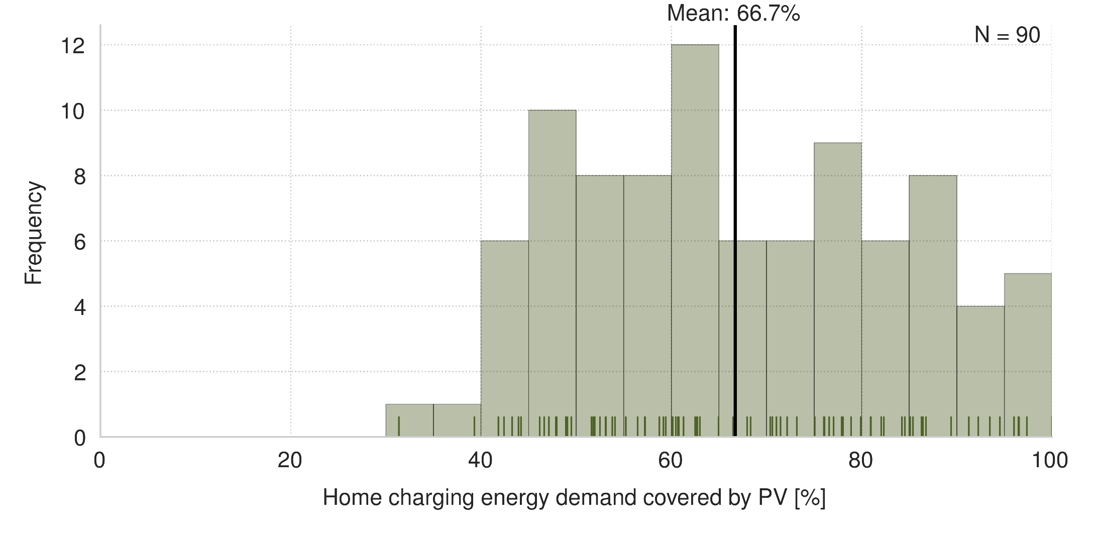
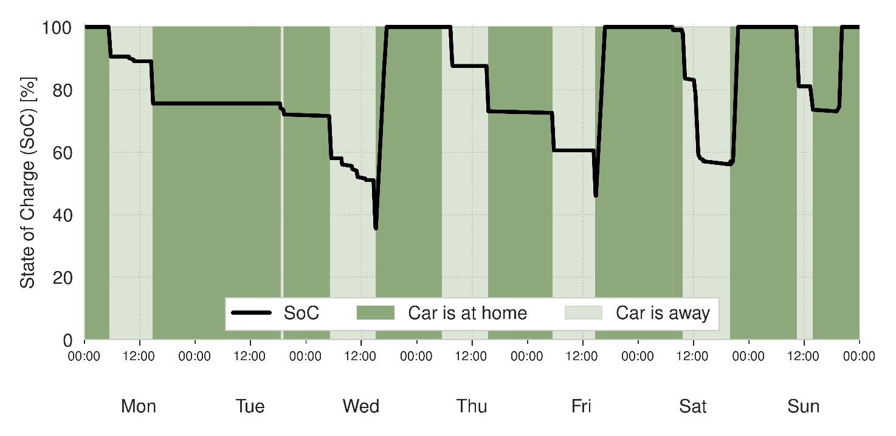
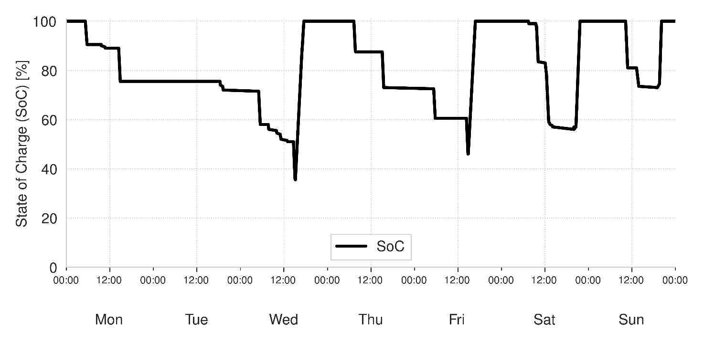
Our users could cover a substantial part of the power demand of their electric vehicle with solar power generated on their roofs
Charging behavior and location of the car for each user
Percentage of locally covered home charging demand for each user
Notes:
With the combination of these data, we have knowledge about the state of charge of the electric vehicle, weather or not the car is at home and the solar generation potential of the home associated to the car. We use these information to calculate how much of the energy demand used for mobility can be covered using local PV generation.

Slide 5

We will be happy to answer your
questions at our Poster!
Notes:
The special feature of our approach is that the results are based on real driving and charging behavior and that we can connect the data of each car to the house it actually belongs to.
Thank you for your attention and I hope to see you all at our booth

